Slide 1
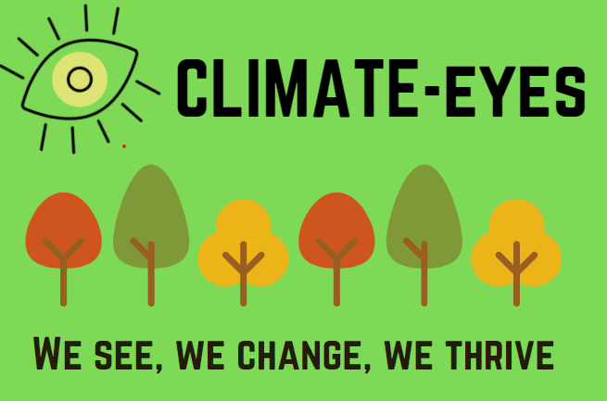

Slide 2
Background to this project
Evolution– looking for published reports
Aim - document lessons learned by rural remote communities in long and difficult droughts.
There is no one source of truth on this
Lived experience - many lessons to share; these can provide insights for other communities
We all have roles to play in climate adaptation and mitigation so there is a wide scope for using information collected

Slide 3
What we were looking for
How climate change impacted people’s daily lives, particularly health and wellbeing
What short and long-term changes were made to cope with this impact
Key learnings to share with other communities
Collate - links to key reports written during drought which may be relevant

Slide 4
How we did it
An online survey/questionnaire open to everyone in the region and promoted via stakeholder newsletters and social media and local media partners.
Case studies with people with lived experience in agriculture, sport, gardening, government, resource management, water, health, education, community, Aboriginal Communities and other areas and record these as case studies.
Subject themes - with an emphasis on lessons learned and actions for others to follow

Slide 5
Survey – what we said
If you have lived in the Wimmera for the past decades you have lived with drought and climate change. We talk about the weather every day but not the impact it has on our lives and our community.
We want to hear your stories of resilience, of being brave and strong and smart and finding new ways of having a lawn, growing veggies, playing a sport, running community events, connecting with your friends. You have plenty to share so please take the time to answer the following questions. If you would prefer to do it over the phone call the number at the end of the survey and we will help you achieve that.

Slide 6
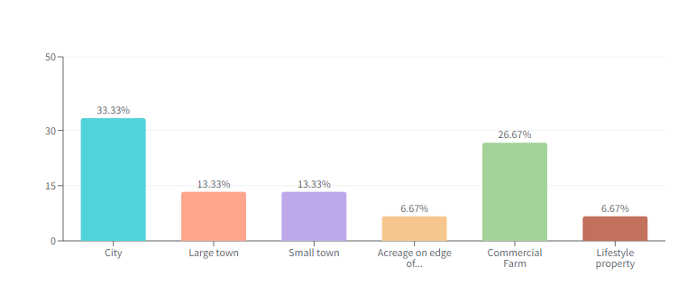
Where they lived – 8/10 lived here more than 20 years

Slide 7
Themes that emerged
Home and family
Garden
Farm
Landscape
Workplace
Sport and Leisure
Health
Community
Innovation

Slide 8
Top 10 tips for family and home
1. Take shorter showers
2. Collect waste water to re-use elsewhere
3. Buy more water-efficient appliances, taps and toilets
4. Visit public green spaces
5. Swim at the local pool
6. Take the opportunity to try new hobbies
7. Set a budget and look for opportunities to save
8. Create shade at home and in the garden
9. Take an afternoon siesta on hot days and go back outside in the evenings
10. Try to find some positives – at the end of long hot days there is often a spectacular and beautiful sunset.
“During the Millennium drought it was a real boon to have native
plants when many others were having to do things like laying down fake lawn or concreting as they could not continue watering.”
Maree Goodes

Slide 9
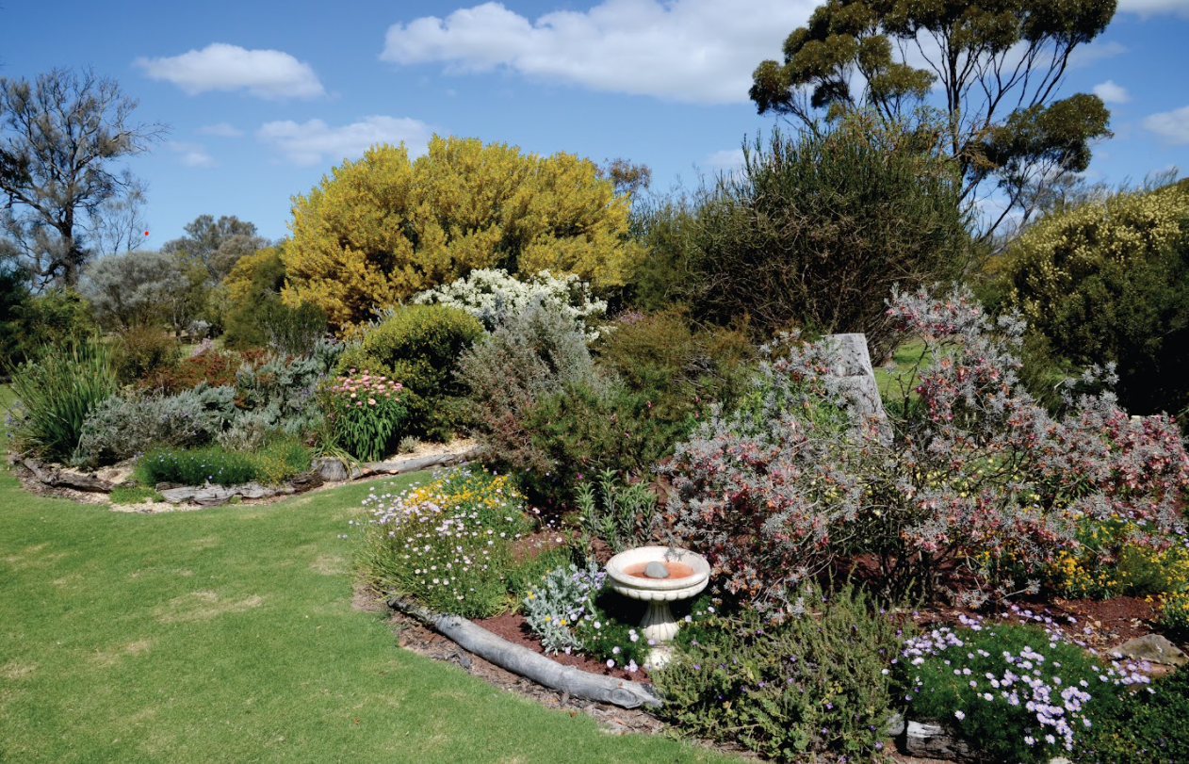
Garden
Garden challenges
Plants died
Dead lawn or bare ground was an eyesore
No lawn for children to play on
Had to use buckets to water the garden
Unable to grow fruit and vegetables
The loss of the garden space was a source of distress to many people in the community
Dust everywhere
Garden solutions in the long-term
Plant drought-tolerant gardens
Grow plants that belong in the local area such as natives, particularly local varieties
Remove plants that are better suited to wetter environments
Remove or reduce grassed areas
Use stones or articifical lawn instead of grass
Build shade structures for vulnerable areas such as the vegetable patch
Install rainwater tanks
Appreciate the reduced maintenance of a native garden or one with less lawn

Slide 10
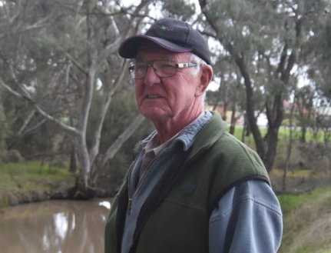
Farm
“We can now do more than survive in a dry climate. What was considered disastrously low rainfall in the early 2000s would now be sufficient to grow a crop on.”
1. Maximise run off to fill dams and store soil moisture
2. Plan for stock feed, grow and store yourown supplies
3. Use technology/research to grow a crop on less water
4. Build stock containment –before the drought
5. Focus on core expenses – breeding stock and low-risk crop
6. Plan financially for tough times or renegotiate loans
7. Business strategies must address good and bad years.
8. Use drought downtime to clean up, repair and improve OHS
9. Look for opportunities to diversify or earn off farm income.
10. Continue to maintain social connections
“We seem to seeing more of this boom and bust pattern, massive excesses of rain then dry periods, so it’s our job to make the most of the moisture whenever it lands.”
David Drage

Slide 11
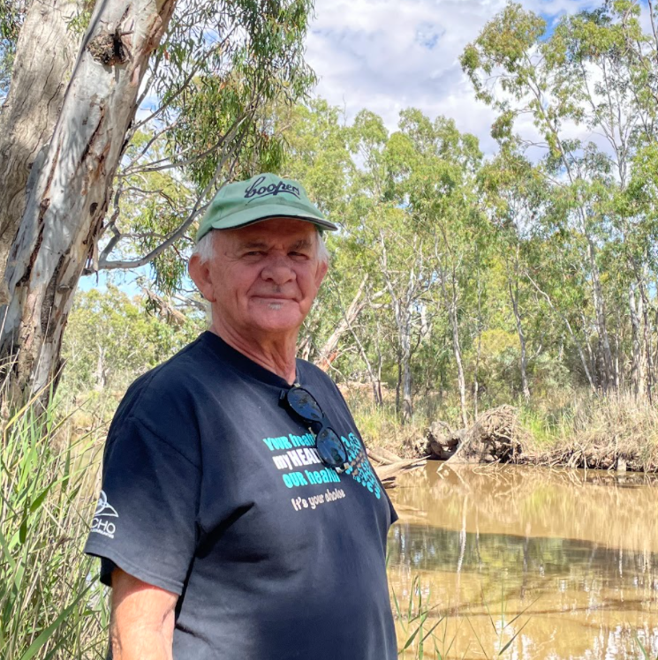
Natural Landscape
“This region is at the vanguard of climate change impacts in Victoria - we are the canary in the coalmine. Some ecosystems are very resilient to drought impacts but many are not. Water in the landscape is vital for community wellbeing/mental health/liveability.” – Greg Fletcher
Top 10 tips for looking after the landscape
Have faith – our ancient landscape is enduring and resilient
Install small water supplies for wildlife in your garden.
3. Prepare your property to reduce the risk of fire
4. Develop a bushfire plan for your family and community
5. Consider artificial frog ponds to support aquatic life
6. Replace your front lawn with natives
7. Don’t stop community tree planting, just plant smarter.
8. Keep your eyes open, think adaptation
9. Find environmental positives
10. Learn from those who have lived this before
Case Study - Ron Marks
“The old folks knew a lot about water and how precious it was and they looked to make the most of every drop.

Slide 12
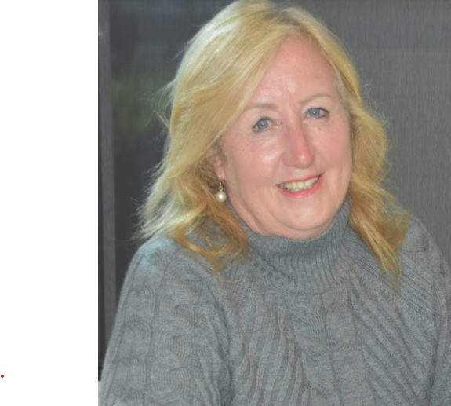
Workplace
Tips for the workplace
1. Be compassionate with staff and clients and respectful of their stress
2. Monitor staff work loads and stress levels, particularly when they are working in difficult situations
3. Accept that some projects and goals may need to be delayed or re-focused
4. Plan for the impact of climate events so that you have some options
5. Support business clients and customers with information and products to help them adapt
6. Look for ways to limit the impact of a reduced income on the business
7. Monitor conditions when working outside, keep out of the heat and drink plenty of water
8. Offer staff Mental Health First Aid training
9. Provide information about support services and adaptation
10. Install shade to reduce the negative impacts of climate change.
*
“The situation I was confronted with as the drought got worse was the struggle for women to help their husbands, sons, neighbours or friends. Mental health had never really struck me as an issue …not at the level where people would be mentioning it when they were getting their hair done.”
Robyn Kelm

Slide 13
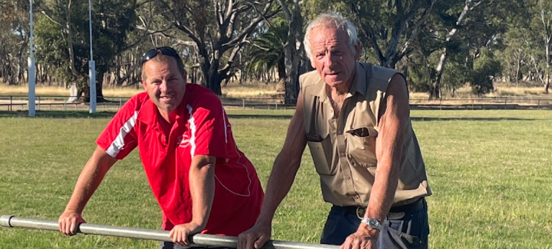
Sport and Leisure
20 years ago Taylors Lake endured its darkest hour when a grass fire, sparked by fairy grass on dry Green Lake decimated the club’s facilities at its Dock Lake Reserve home base…. “We won’t ever have a repeat of that day because there have been a number of changes,” Travis Mackley
1. If your lake is dry, visit the local pool for a dip
2. Seek funding to adapt sporting facilities
3. Share sporting facilities that have more drought-resistant facilities
4. Arrange social activities to maintain participation
5. Walk or exercise in the cool of the day.
6. Celebrate water when it is available
7. Consider new pursuits if your usual activity is hit by climate change.
8. Change afternoon sport to evening during summer
9. Turn your dry lake into a concert venue
10. Celebrate your resilience and endeavours together.
“The town storm water was collected in a dam and pumped by solar power pump to the bowling green and the sports oval. It kept the grass alive until the drought broke in in 2011.”

Slide 14
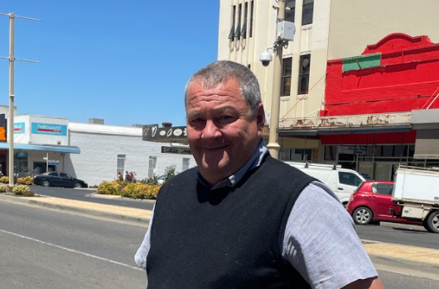
Health
“Looking at endless blue skies all winter, or watching clouds roll in and only provide thunder and lightning - which some times causes fires as well –was soul destroying. Droughts really mess with your capacity for hope.”
1. Stay connected – talk to others
2. Spend quality time with family and friends
3. Attend events
4. Exercise regularly or take up a sport
5. Develop good sleep habits
6. Limit alcohol
7. Prioritise to avoid over-commitment
8. Be realistic in your expectations
9. Focus on the positive
10. Talk to your doctor or a counsellor
“Given we’re such a strongly agricultural
region and there can be so much situational
stress in those tough years, so having more
support is only going to benefit the region as a whole.”
Geoff Witmitz

Slide 15
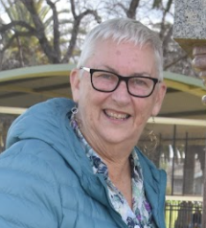
Community
“The big drought concert attracted over 20,000 people to Longerenong in 2007. There was also a big photo shoot at Edenhope where the whole town turned out on the dry Lake Wallace and had their photo taken. At Albacutya it was a concert with an orchestra.”
Top 10 tips in the community
1. Stay active and engaged with your community
2. Be attentive listeners when interacting with others
3. Organise, help or attend community events
4. Seek funding to support free or subsidised events.
5. Work together find adaptive solutions
6. Organise and/or attend Mental Health First Aid
7. Be adaptive – if you can’t ski hold a dry lake event
8. Celebrate the positives
9. Don’t be afraid to dream big
10. Be kind to each other and open minded to solutions
“What the pipeline has showed is where you have water you have life. We just need to remember things are cyclical and to invest in your community, your people and your environment when things are good. It’s a little like a bank, you put away some credits in the good time to draw down on when things are a bit tougher.”
Jo Bourke

Slide 16
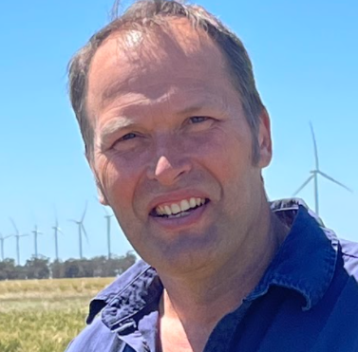
Innovation
“Health workers educated residents about the need to protect their
health in heatwaves and created some great cultural changes which
probably save lives on the worst heat health days.”
Tips for innovation
Saving water through piping, capturing run off
Changing agricultural farming systems
Fund for social connection – Look over the farm gate
Educate your community - Mental Health First Aid from hairdresser question
Change how you live - Fake grass and shade sails
Necessity is the Mother of invention
Find new ways to work together – Heat health
Dream big as you adapt to the changing situation
“Rural life is about more than just agriculture, we want to live in vibrant communities so we need to push hard to ensure there are jobs available in our rural and regional towns , that there are
services, that there are leisure and recreational opportunities.”
David Jochinke

Slide 17
Children
I have very strong memories of being in school and always always having Phil the Bucket come visit… school cluster days based around saving water/sustainability: having a bucket in the shower to water the garden with and quick showers, luxurious 5 minute long ones once a week to wash your hair……AND finally: when the floods came at school we went wading through the waters as a class
Our kids missed out on the joy of playing under a sprinkler and
the first time they got to see and play under a sprinkler - when visiting
their grandparents outside the drought zone - they were so excited. That
says a lot about what our household missed out on in drought.
Our kids were nuts about puddles. One time when we were away from
home, all they wanted to do was stomp in puddles.

Slide 18
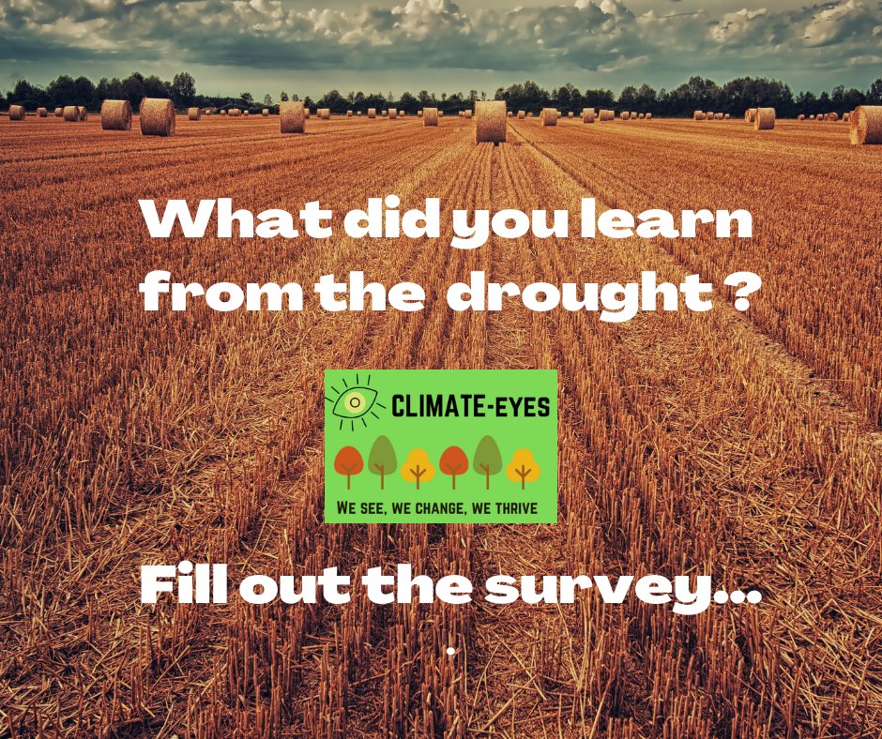
Observations
So many stories and we have only just scratched the surface
There is a strong local understanding of the impact of global warming
We have mostly talked about drought
Strong understanding of social connections
Pipeline was a major innovation
It is not easy to get people to fill in a survey.

Slide 19
Thank you – questions

